Slide 1



CEPDT PROJECT · SMART AGRICULTURE
Smart Irrigation System
From a Tinkercad Circuit Simulation to an Interactive 3D Digital Twin
Tinkercad · Arduino Uno
Three.js · WebGL Scene
Automated Moisture Control

Slide 2



Project Overview
A two-part build: a working circuit prototype, and a real-time 3D visualization that brings it to life.
Sense Soil Moisture
A soil-moisture probe and TMP36 temperature sensor continuously feed live readings to the Arduino Uno.
Set a Custom Threshold
A 250 kΩ potentiometer lets the operator dial in exactly how dry the soil must get before watering starts.
Automate the Response
When soil crosses the threshold, the Arduino drives a DC pump motor, alert LEDs and a piezo buzzer automatically.
Display & Visualize
Readings appear on a 16×2 I2C LCD in the physical build — and on a live HUD inside a full 3D farm digital twin.

Slide 3


System Architecture
The Arduino Uno sits at the center, reading sensors and driving outputs in real time.
INPUTS
OUTPUTS
Soil Moisture Sensor
DC Pump Motor
Analog probe in the bed
Drives irrigation
→
→
TMP36 Sensor
16×2 I2C LCD
Ambient temperature
On-device readout
Arduino Uno R3
the control loop
Threshold Dial
Buzzer + LEDs
250 kΩ potentiometer
Dry-soil alerts

Slide 4

PART ONE
Circuit Design in Tinkercad
Prototyping the sensing and control hardware before writing a line of code.

Slide 5
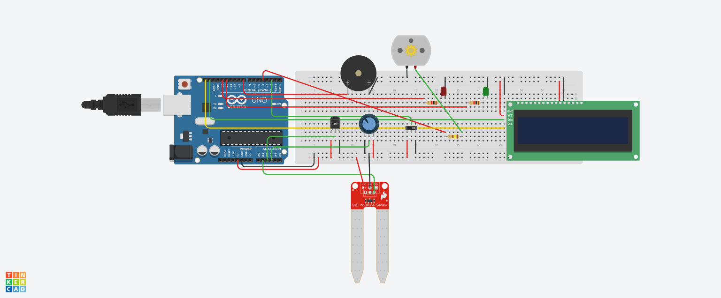
The Circuit
Simulated end-to-end in Tinkercad before any hardware was assembled.
Arduino Uno R3 — control unit
Soil Moisture Sensor — reads soil water content
TMP36 Sensor — ambient temperature
DC Pump Motor — irrigation actuator
16×2 I2C LCD — on-device readout
250 kΩ Potentiometer — threshold dial
Full schematic — Tinkercad Circuits simulation
Piezo Buzzer + LEDs — dry-soil alerts
12
1
100%
Slide Switch + Resistors — power & current control
Components
Microcontroller
Simulated First

Slide 6
Bill of Materials
Every component used in the Tinkercad build.
Ref | Component | Qty
D1 | Red LED | 1
D2 | Green LED | 1
U1 | Arduino Uno R3 | 1
M1 | DC Motor | 1
SEN1 | Soil Moisture Sensor | 1
U2 | Temperature Sensor (TMP36) | 1
PIEZO1 | Piezo Buzzer | 1
— | Breadboard | 1
U7 | 16×2 I2C LCD (MCP23008, 0x20) | 1
Rpot3 | 250 kΩ Potentiometer | 1
S1 | Slide Switch | 1
R3, R4 | 1 kΩ Resistor | 2
R2 | 139 Ω Resistor | 1

Slide 7
How the Circuit Works
From raw sensor signal to automatic watering, in four steps.
1
2
3
4
Sense
Compare
Decide & Act
Display
Soil-moisture and TMP36 sensors sample the bed and feed raw values to the Arduino every cycle.
The Arduino compares the live reading against the threshold set on the potentiometer dial.
Below threshold: pump, red LED and buzzer switch on. Above it: the green LED stays lit and it idles.
Moisture, temperature and system state are pushed to the 16×2 LCD in real time.

Slide 8

PART TWO
A 3D Digital Twin, Built in Three.js
The same irrigation logic, reimagined as an explorable, real-time farm scene in the browser.

Slide 9

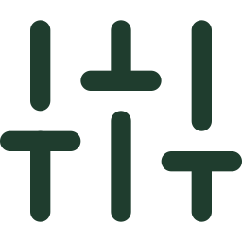



Inside the Scene
A procedurally-textured farm — sky, soil, crops and machinery — rendered live with WebGL, zero external image assets.
Sky & Weather
Water Tank & Crops
Control Pad Dial
Dynamic sky dome with drifting clouds and a toggleable rain system.
A modeled tank, windmill, shed and planted crop beds fill out the farmstead.
A draggable in-scene dial sets the moisture threshold, mirroring the potentiometer.
Live HUD
Day / Night Cycle
Zero Image Assets
Moisture, threshold, temperature, rain, tank and state, updated every frame.
Lighting, fog and sky tint shift smoothly between day and night.
Grass, soil, concrete and wood textures are all generated on canvas at runtime.

Slide 10

Play With It
The scene isn't just a render — it responds to input in real time.
Live HUD Readout
Draggable Threshold Dial
One-Click Dry Soil
Moisture, threshold, temp, rain, tank and state at a glance.
Grab the control-pad dial to retune the watering threshold live.
Trigger a dry-soil event instantly and watch the response cascade.
Rain Trigger
Day / Night Toggle
Orbit & Zoom
Simulate rainfall and watch the tank and HUD react.
Switch lighting and mood with a single click.
Drag to orbit the camera, scroll to zoom through the farm.

Slide 11
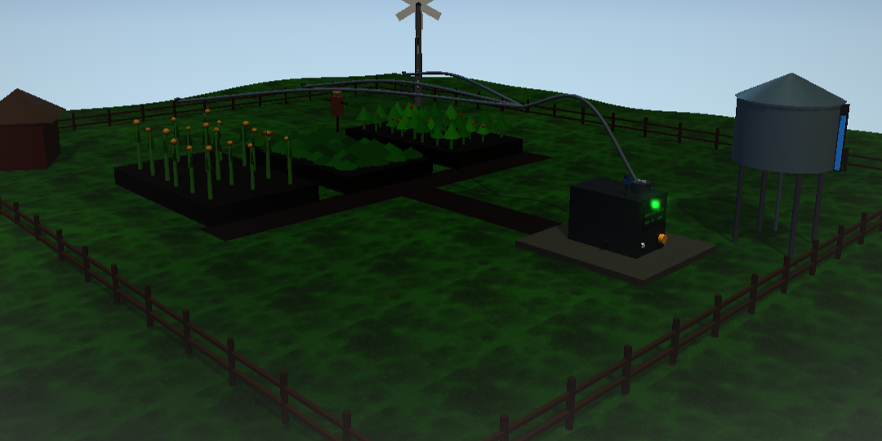
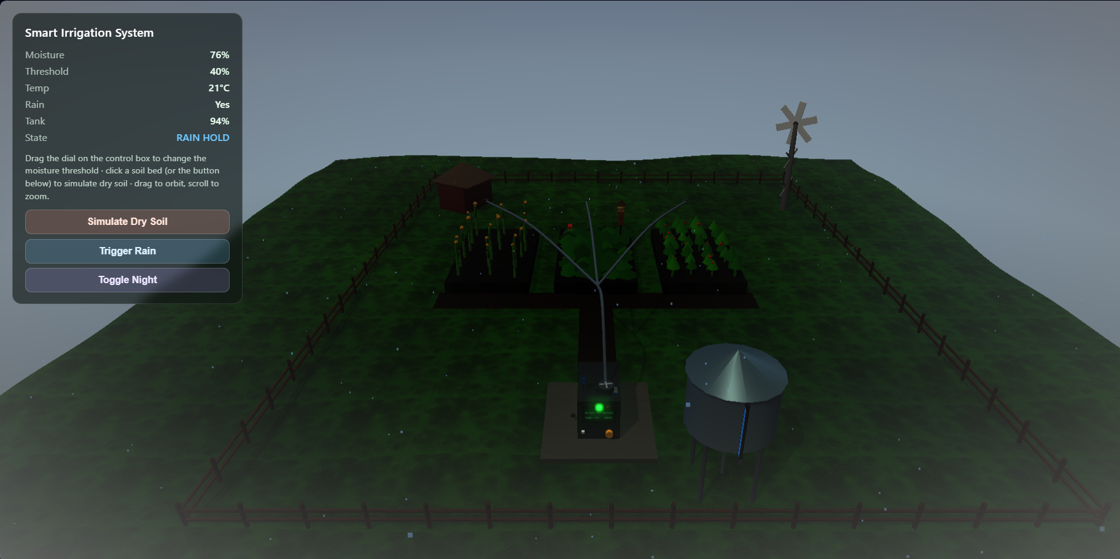
The Digital Twin in Action
Screenshots captured live from the Three.js scene running in the browser.
IDLE
LIVE HUD
Farm view: soil moisture is above the threshold
Rain hold at night, with the live dashboard
The green status LED on the control box stays lit and the pump stays off while the soil is healthy.
Moisture 76%, threshold 40%, tank 94%: rain and night mode are on, so the system holds off pumping.
Notes:
These are live screenshots from our Three.js digital twin. On the left, the farm in its idle state - moisture is above the threshold, so the green LED is on and the pump is off. On the right, the live dashboard during a rainy night: moisture 76 percent, threshold 40 percent, tank 94 percent, and the state reads Rain Hold because rain alone is rehydrating the soil.

Slide 12
Two Builds, One System
A physical prototype and a digital twin, both modeling the same irrigation logic.
Physical Prototype
Digital Twin
TINKERCAD
THREE.JS / WEBGL
Real Arduino Uno C++ logic on breadboard-accurate wiring
Full 3D farm environment rendered live in any modern browser
Validates sensor thresholds and component behavior before buying hardware
Real-time HUD plus interactive threshold dial, rain and day/night triggers
LCD, buzzer and LED feedback exactly as it runs on real hardware
Zero build step — static HTML/JS/CSS loaded straight from a CDN import map
Safe place to debug circuits, with zero risk of shorts
Ideal for demos, presentations and exploring “what if” scenarios instantly

Slide 13


Impact & What's Next
What this project demonstrates — and where it can go.
IMPACT
FUTURE SCOPE
Bridges hardware prototyping and software visualization in one project
Stream live sensor data from the real board into the 3D HUD
Demonstrates a full sense → decide → act embedded control loop
Solar-powered, field-deployable version of the circuit
Built entirely from low-cost, widely available components
Companion mobile app for remote threshold control
The digital twin makes the system explainable to a non-technical audience
Multi-zone irrigation with per-bed moisture mapping

Slide 14



CONCLUSION
One irrigation loop,
built twice
Automated, closed-loop control
Soil moisture dropping below the potentiometer threshold switches on the pump, red LED and buzzer; recovery returns the system to a green idle.
We designed a complete smart irrigation system: a Tinkercad Arduino circuit that senses soil moisture, decides against a dial-set threshold and acts automatically, and a Three.js digital twin that lets anyone watch that same logic run live in the browser.
Validated before any hardware
The full circuit was simulated in Tinkercad, so wiring, thresholds and component behaviour were tested with zero risk of shorts.
4
2
0
Explainable to anyone
The Three.js digital twin mirrors the same logic live, with a draggable dial plus rain and day/night controls, in any modern browser.
step sense-to-act loop
builds sharing one logic
image files in the 3D scene
Notes:
To conclude: we built one irrigation system in two ways. The Tinkercad circuit proves the sense-decide-act loop works - the Arduino reads soil moisture, compares it with the threshold on the potentiometer, and switches on the pump, red LED and buzzer when the soil is too dry. We validated all of that safely in simulation before touching hardware. The Three.js digital twin then mirrors the same logic in a browser - with a draggable dial, rain and day/night controls - and uses zero image files, since every texture is generated in code. Together they show how hardware prototyping and software visualization fit into one workflow.

Slide 15



References
Tools, platforms, datasheets and project files used to build the system.
Software & Platforms
Hardware Docs
Project Files & Credits
[1]
Autodesk Tinkercad Circuits
[5]
Arduino Uno Rev3
[9]
Smart Irrigation System .pdf / .png
Circuit design and simulation
Board specifications and pinout
Tinkercad circuit schematic export
tinkercad.com/circuits
docs.arduino.cc/hardware/uno-rev3
Project folder
[2]
Three.js (r160)
[6]
TMP36 Temperature Sensor
[10]
bom.csv
3D engine, OrbitControls, bloom effect
Analog Devices datasheet
Tinkercad bill of materials export
threejs.org/docs
analog.com/en/products/tmp36.html
Project folder
[3]
WebGL (Khronos Group)
[7]
MCP23008 I/O Expander
[11]
index.html · style.css · main.js
Web graphics standard behind Three.js
Microchip datasheet (I2C LCD interface)
Three.js digital twin source code
khronos.org/webgl
microchip.com/en-us/product/MCP23008
Project folder
[4]
jsDelivr CDN
[8]
Arduino LiquidCrystal Library
[12]
Feather Icons (MIT licence)
Serves three@0.160.0 via an import map
16×2 LCD control reference
Icon set used throughout this deck
jsdelivr.com/package/npm/three
docs.arduino.cc/libraries/liquidcrystal
feathericons.com
Notes:
These are the sources behind the project: Tinkercad Circuits for the simulation, Three.js and WebGL for the 3D digital twin, the Arduino, TMP36 and MCP23008 documentation for the hardware, and our own project files - the schematic, bill of materials and source code.

Slide 16
Thank You
Smart Irrigation System — Tinkercad Circuit & Three.js Digital Twin

